Slide 1


DS1001 / JAN-MAY 2024
Session 1
Team #32
-CS23B1092 , CS23B1059 , CS23B1090
CS231005 , CS23I1014 , CS23I1017
CS23I1026 , C23I1027 , CS231029
CS23I1037 , CS23I1065

Slide 2

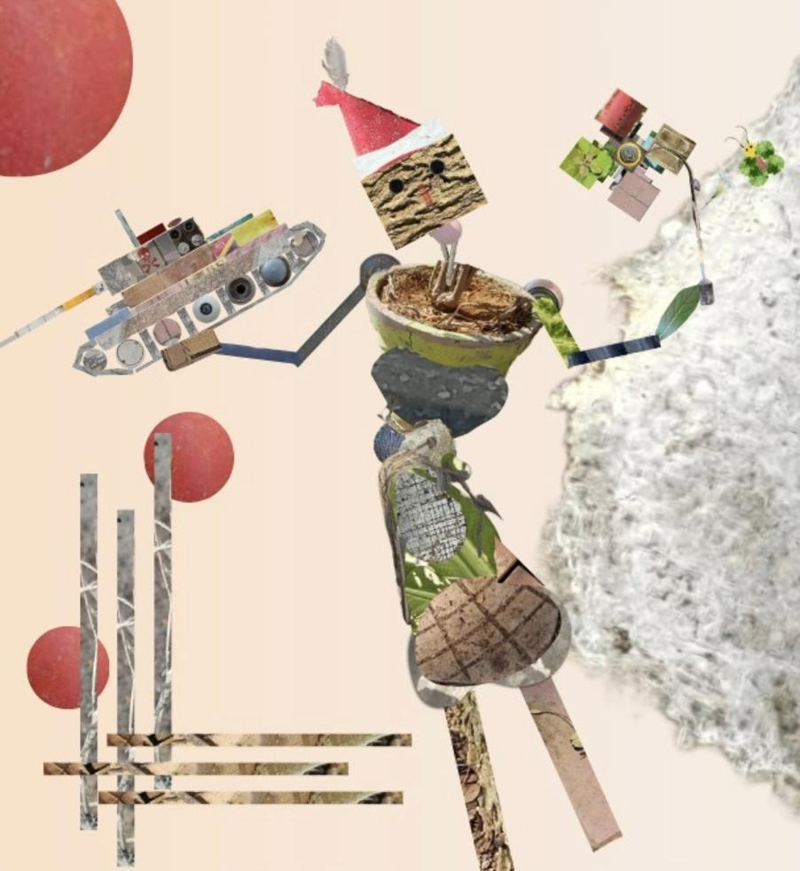


NATURE & MODERNISATION: A DELICATE BALANCE

Slide 3

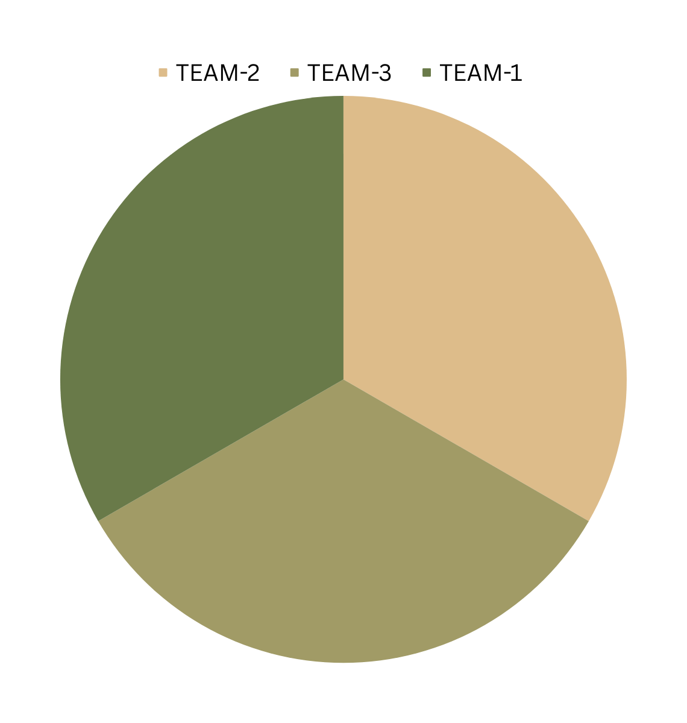
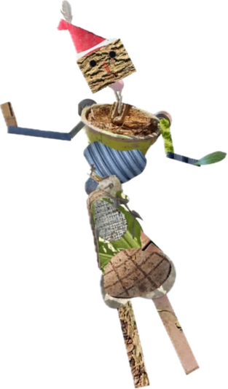
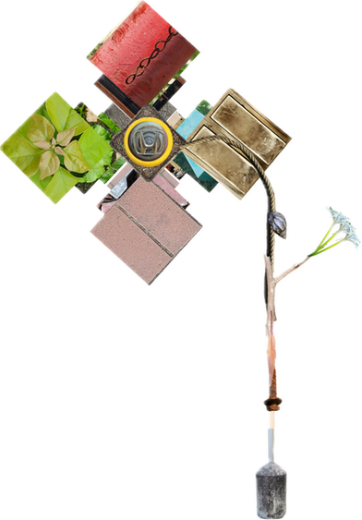

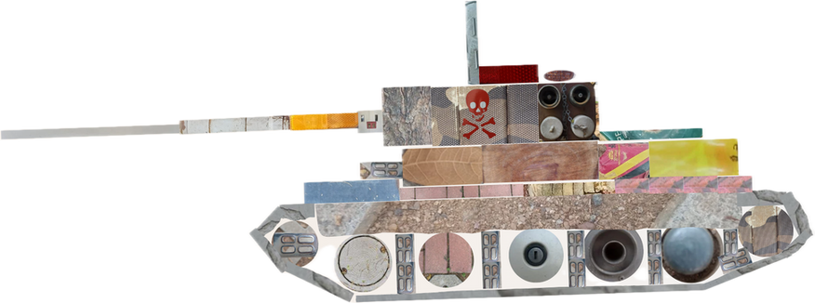
TEAM-1
CS23I1027
CS23I1014
CS23B1059
CS23I1065
TEAM-2:
CS23I1029
CS23I1005
CS23B1090
CS23I1026
TEAM-3: CS23I1017 CS23B1092 CS23I1037

Slide 4

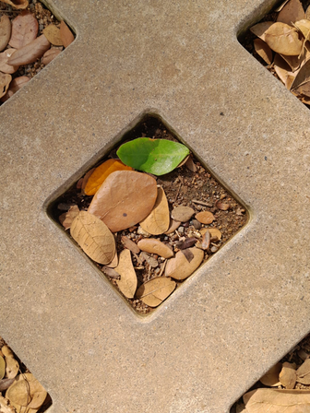
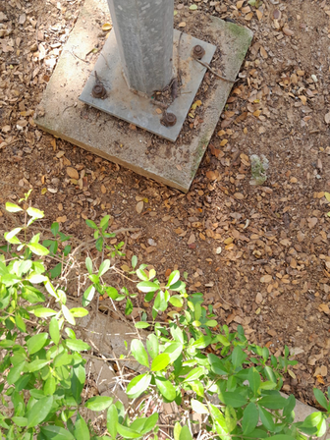
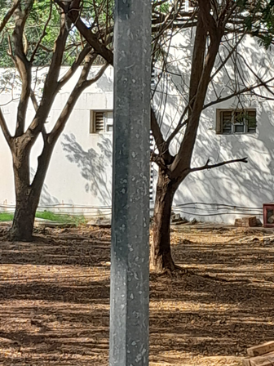
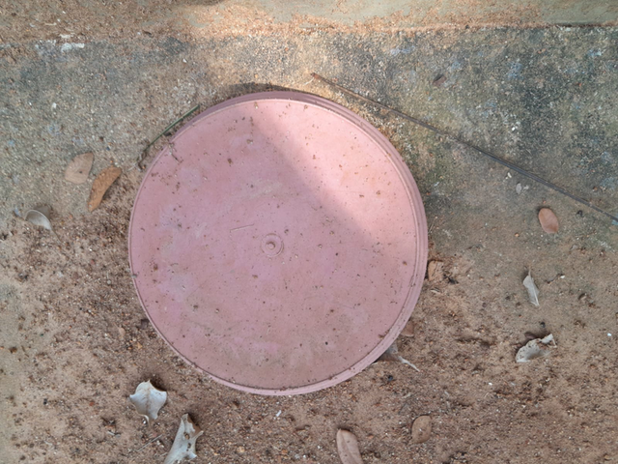
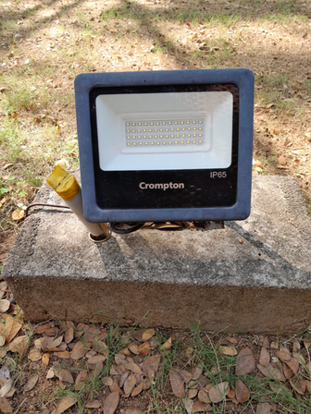
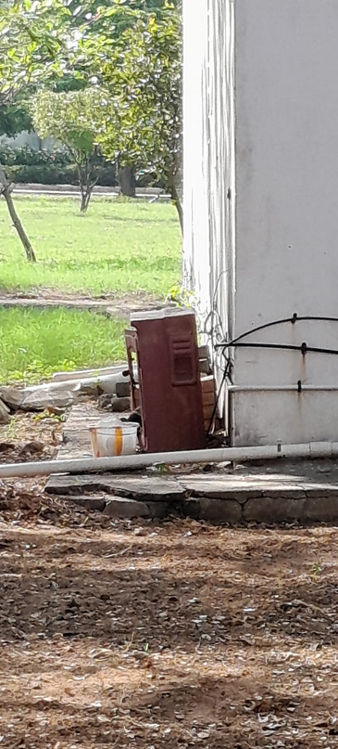
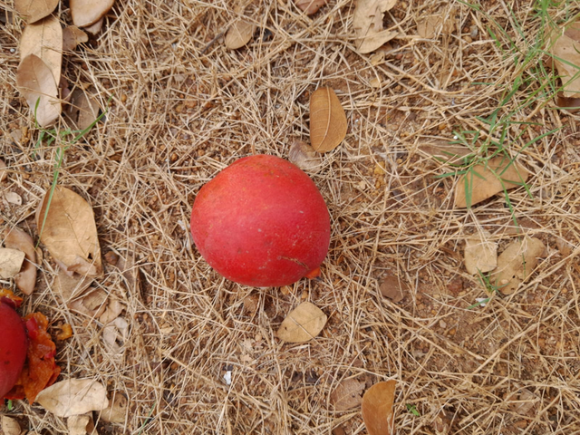
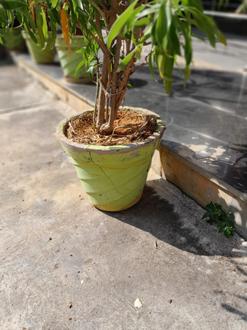
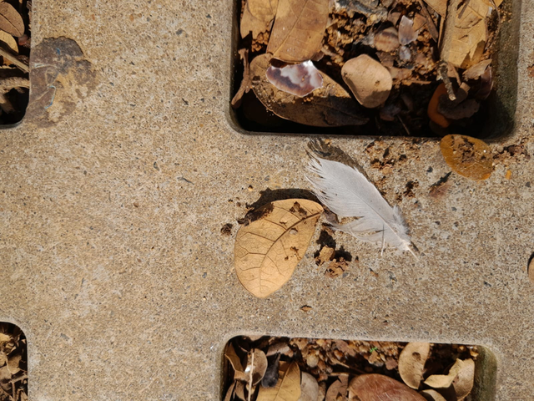
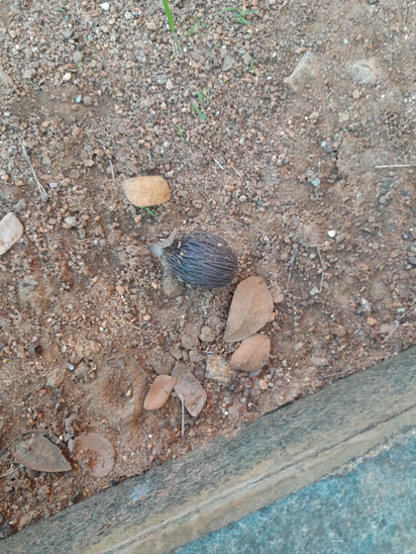

CS23I1017 - HARITH

Slide 5
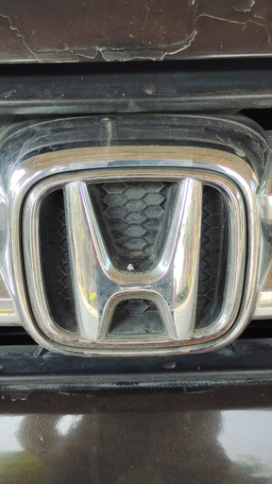
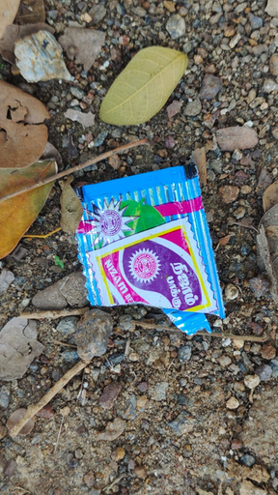
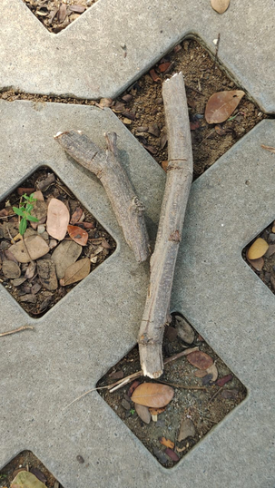
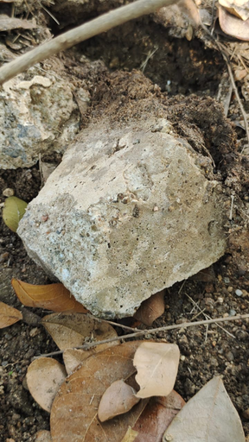

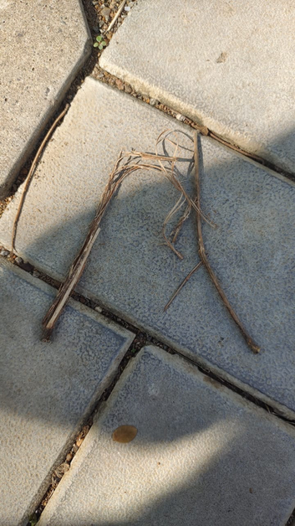
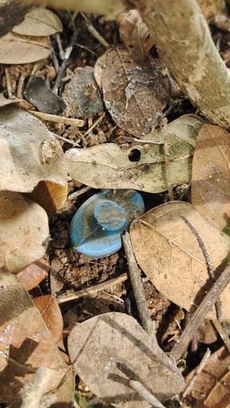
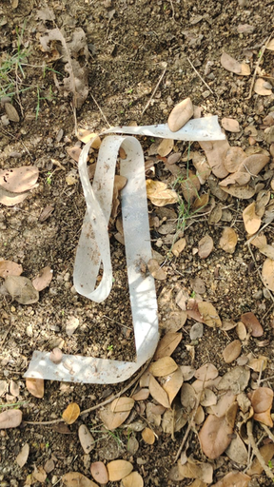
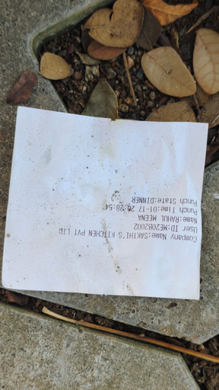

CS23I1014-BHADRESH

Slide 6

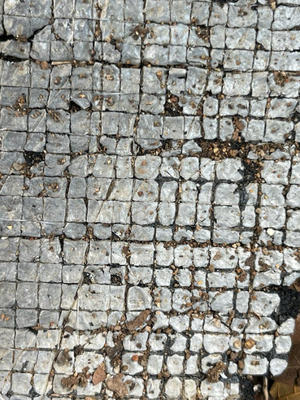
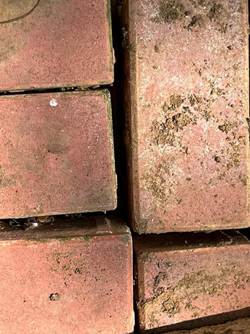
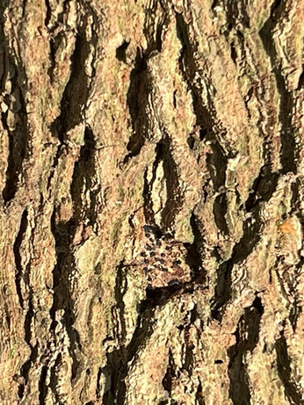
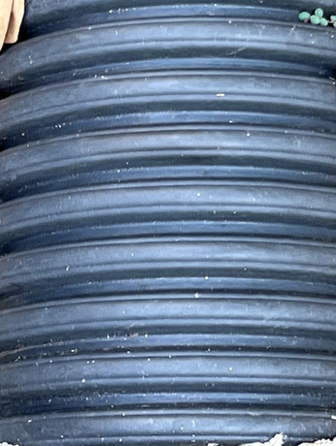
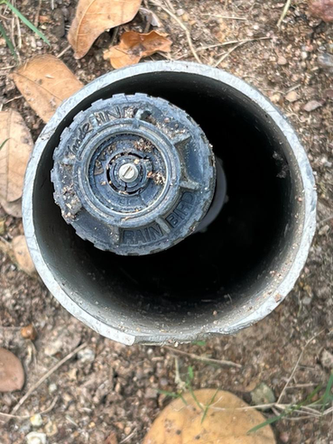
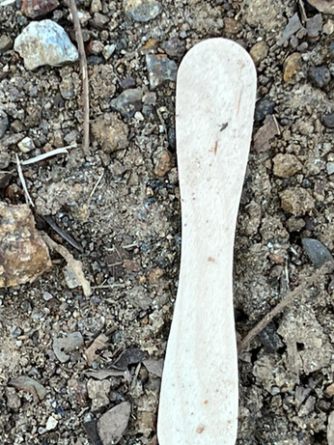
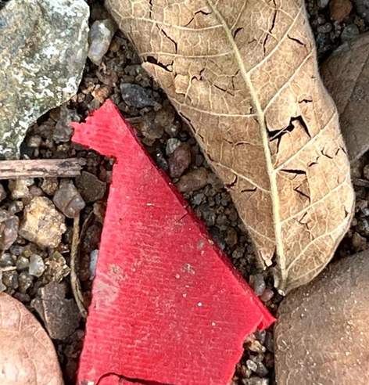
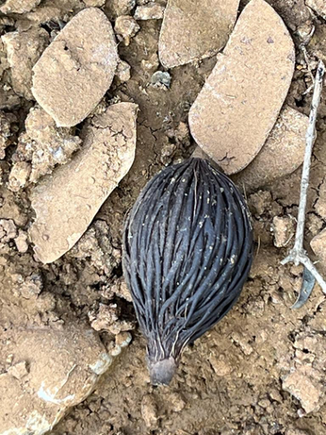
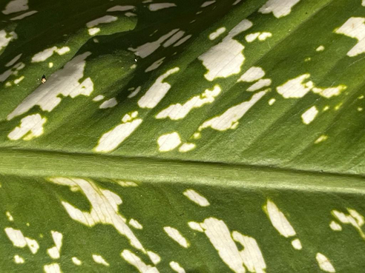
CS23B1059-ANVITA

Slide 7
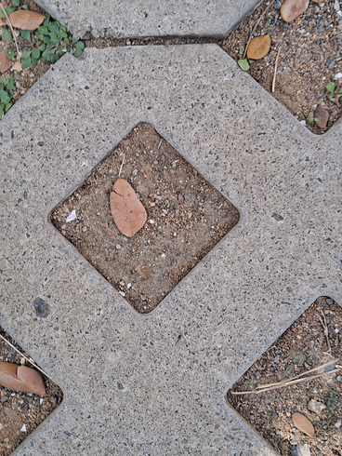
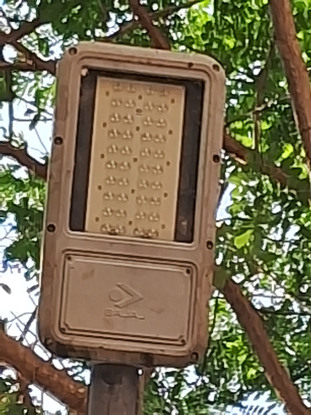
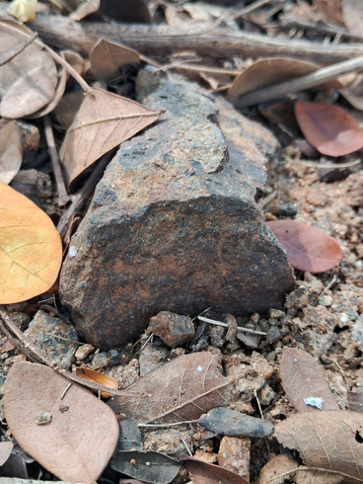
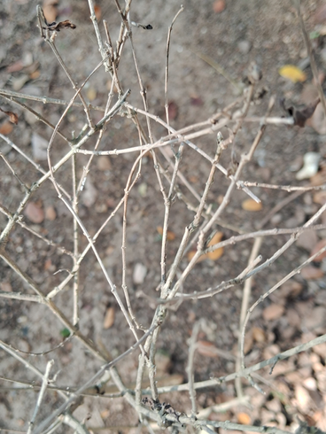
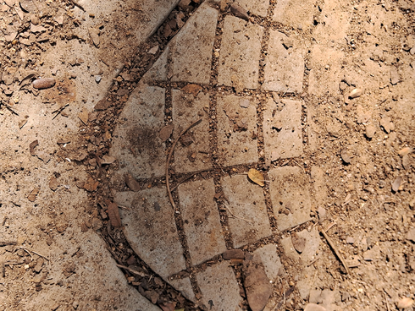
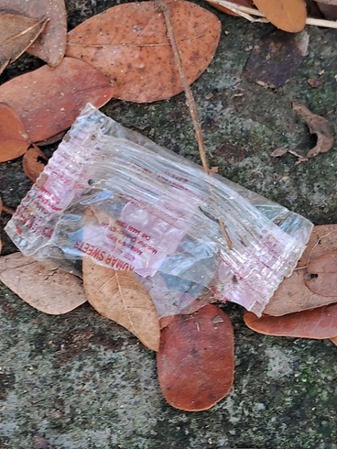
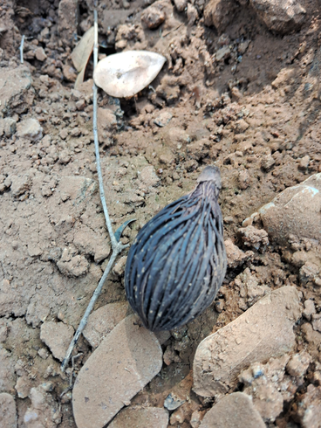
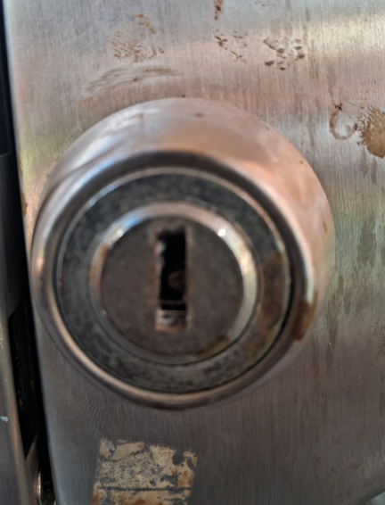
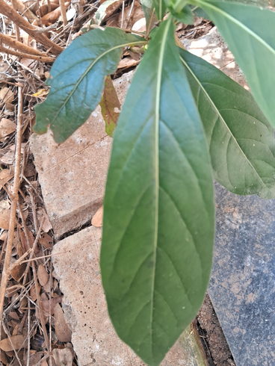
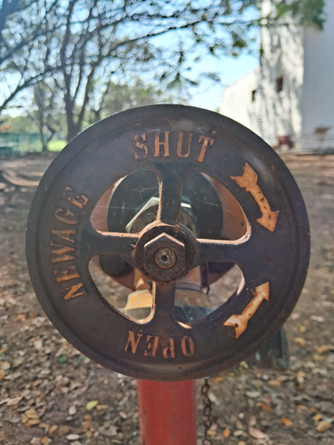
CS23I1065-SANTHANA SRINIVASAN

Slide 8
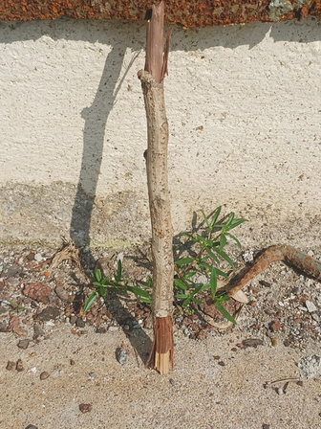
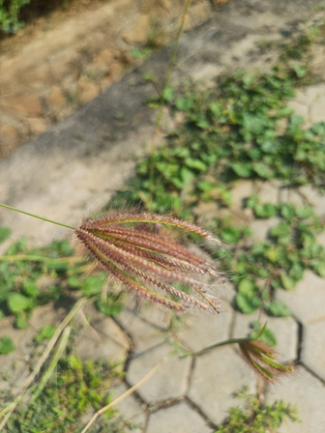
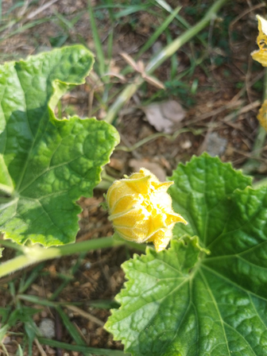
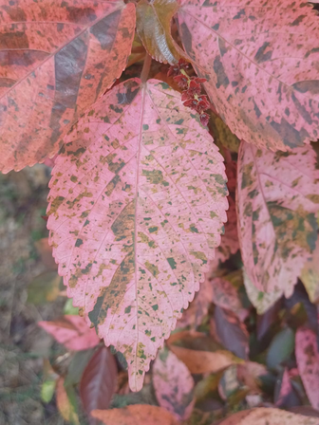
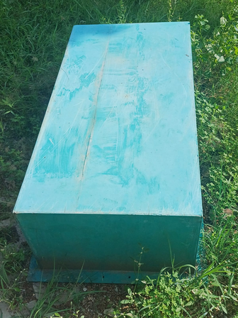
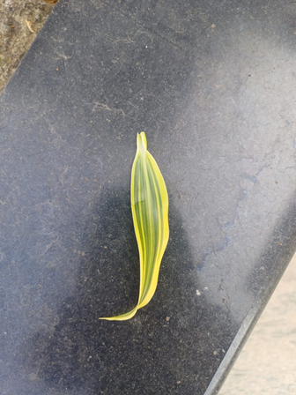
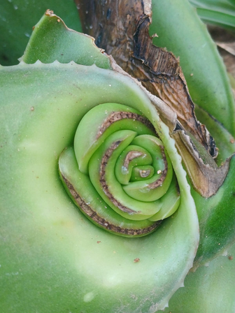
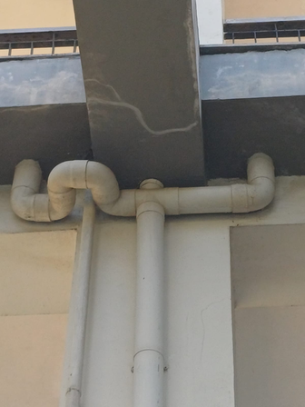



CS23I1029-ADITYA

Slide 9










CS23I1005-BARATH

Slide 10










CS23I1090-NISARG

Slide 11










CS23I1026-GRISHMANK

Slide 12










CS23I1017-PRIYANK

Slide 13










CS23I1037-YASWITHA

Slide 14
CS23I1037-YASWITHA

Slide 15










CS23B1092-SAHITYA

Slide 16
DS1001 / JAN-MAY 2024
Session 2
Team #32
-CS23B1092 , CS23B1059 , CS23B1090
CS231005 , CS23I1014 , CS23I1017
CS23I1026 , C23I1027 , CS231029
CS23I1037 , CS23I1065

Slide 17

NATURE & MODERNISATION: A DELICATE BALANCE

Slide 18



TEAM-2:
CS23I1029
CS23I1005
CS23B1090
CS23I1026
TEAM-1
CS23I1027
CS23I1014
CS23B1059
CS23I1065
TEAM-3: CS23I1017 CS23B1092 CS23I1037 CS23I1032

Slide 19










CS23I1017 - HARITH

Slide 20










CS23I1014-BHADRESH

Slide 21










CS23B1059-ANVITA

Slide 22










CS23I1065-SANTHANA SRINIVASAN

Slide 23










CS23I1029-ADITYA

Slide 24











CS23I1005-BARATH

Slide 25










CS23I1090-NISARG

Slide 26










CS23I1026-GRISHMANK

Slide 27










CS23I1017-PRIYANK

Slide 28










CS23I1037-YASWITHA

Slide 29










CS23I1032-DEETYA

Slide 30










CS23B1092-SAHITYA

